Slide 1


Performance Testing
Presenter
Mohammad Anees Alam
Notes:
1

Slide 2
Topics for today!
Performance testing overview
Importance & types
Key Performance metrics
Performance testing strategies
Deep dive : Load/Stress/Soak testing
Integrating Performance testing with CI/CD
Hands-on Activities
Notes:
2

Slide 3
What is performance testing ?
Performance testing is a non-functional testing method used to evaluate how fast, stable, and reliable an application is when handling different levels of user activity or traffic.
Think of it like this: "Can your app handle 1000 users hitting it at once — without slowing down or crashing?"
Why is Performance Testing Important for DevOps Engineers?
  Ensures your app responds quickly even under heavy user load
  Helps you identify and fix bottlenecks before users experience them
  Prevents unexpected downtime and system crashes
  Keeps the user experience smooth and reliable
  Enables confidence in your CI/CD pipelines by catching performance issues early in development
Notes:
3

Slide 4
Types of Performance Testing
Load Testing
Stress Testing
Soak Testing
Measures how the system performs under normal expected traffic.
Pushes the system beyond its limits to find where it breaks.
Checks how the system behaves under continuous heavy load over a long duration.
Spike Testing
Volume Testing
Scalability Testing
Evaluates how the system handles sudden spikes in user traffic.
Tests performance when working with huge amounts of data.
Verifies how well the system can scale up or down as user load changes.
Notes:
4

Slide 5
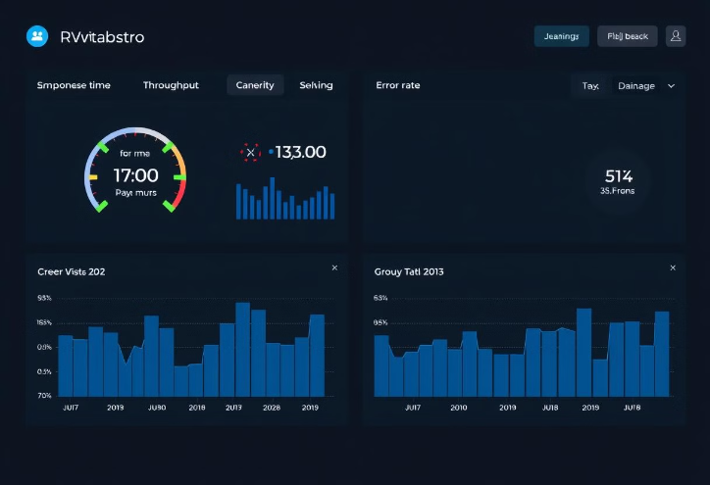
Key Performance Metrics
  Response Time: Time taken to respond to a request.
  Throughput: Number of requests handled per second.
  Latency: Delay between request and first response byte.
  Concurrent Users: Number of users accessing the system at once.
  Error Rate: % of failed requests.
  CPU Usage: % of CPU used during the test.
  Memory Usage: How much RAM is consumed.
  P95/P99 Percentile: Time within which 95%/99% of requests completed.
  Max/Min Response Time: The best-case and worst-case times.
Notes:
5

Slide 6
Performance Testing Strategy
Define Objectives:
Identify Key Scenarios:
What are we testing? What is the target throughput?
Which endpoints matter most? Focus on high-traffic flows.
Prepare Test Data:
Choose the Right Tool:
Ensure the app has realistic data.
JMeter, Locust, k6, Gatling.
Set Load Parameters:
Execute the Test:
How many users? Ramp-up time? Test duration?
Run the test in a controlled environment.
Analyze the Results:
Optimize and Retest:
Look at response times, throughput, failures.
Fix slow queries, increase server resources. Before jumping into tools, understand how to plan performance tests.
Ex: Verify my API handles 500 users with <2s response time.
Notes:
6

Slide 7
Loading Testing
  Load testing is essential for assessing how a system performs under expected and peak loads. It helps identify bottlenecks, scalability issues, and ensures system stability.
  DevOps Impact: Prevents crashes during traffic spikes (e.g., Black Friday sales).
Ensures Scalability
1
2
Prevents Downtime
Optimizes Infrastructure
3
4
Ensures SLAs & SLOs Compliance
Avoids Costly Failures
5
Used-case:
  Netflix uses Locust to simulate millions of users before launches.
Notes:
7

Slide 8



Load Testing Tools
Tool
Language
Best for
JMeter
Java
GUI-based & API testing
Gatling
Scala
API & backend testing
Locust
Python
Distributed testing
Notes:
8

Slide 9
Deep Dive into Loading Testing tools
JMeter
Gatling
Locust
  A free, GUI-based tool used to test the performance of web apps and APIs.
  A powerful load testing tool built with Scala.
  A lightweight, Python-based load testing tool.
  Uses an easy-to-read DSL (Domain-Specific Language) to write test scenarios.
  Lets you define user actions using regular Python code.
  Supports many protocols like HTTP, FTP, JDBC, SMTP, and more.
  Supports distributed testing to simulate thousands of users.
  Great for high-speed, high-volume API testing.
  Offers built-in graphs and reports for analyzing test results.
  Can test multiple endpoints at the same time — very flexible for developers.
  Provides real-time dashboards and detailed results.
  Can simulate thousands of users with distributed testing.
  Best suited for backend and API performance testing.
  Easily fits into DevOps pipelines using tools like Jenkins or GitHub Actions.
Notes:
9

Slide 10
Hands-on Activity
Load Testing with JMeter:
Objective: Installing JMeter, setting up a test plan, and running your first load test.
Install JMeter & verify the installation
1
Click here
2
Launch JMeter GUI
Command: jmeter
Create a test plan
3
Right-click on Test Plan in the left panel.
Select Add → Threads (Users) → Thread Group.
4
Configure the test group
Number of Threads (Users): 100
Ramp-Up Period (seconds): 10
Add HTTP Request Sampler
5
Loop Count: Uncheck "Infinite" if checked.
Right-click on Thread Group.
Save your test plan.
    Select Add → Sampler → HTTP Request.
In the right panel, configure:
Add Listeners for test results
    Server Name or IP: Enter the target website.​
6
    Path: Enter the endpoint you want to test (e.g., /pwskills/courses).
  Right-click on Thread Group.
    Select Add → Listener → View Results Tree & Summary Report.
Start the load test
7
Monitor the test tesults from results tree & summary report.
Notes:
10

Slide 11
Stress Testing & Soak Testing
Stress Testing
Soak Testing
  Pushes the system beyond normal capacity to find its breaking point.
  Checks how the system performs under a steady load over a long duration.
  Helps identify how and when the system fails under extreme conditions.
  Useful for spotting issues like memory leaks or gradual slowdowns.
  Prepares systems to handle unexpected traffic spikes.
  Verifies system stability during continuous use.
  Example: Simulating a jump from 100 to 5000 users in a short time.
  Example: Running 1000 users non-stop for 24 hours.
Notes:
11

Slide 12
Differences : Load, Stress & Soak Testing
  The difference lies in how you configure the test, not the tool itself.
Testing Type
Purpose
Key Focus
Example Scenario
Load Testing
Measures performance under expected user load
Response times, throughput, resource utilization
Checking if an API can handle 1,000 concurrent users smoothly
Stress Testing
Tests system beyond its limits to find breaking points
Failure thresholds, crash behavior, recovery
Gradually increasing traffic until the server crashes
Soaking Testing
Checks system stability over an extended period
Memory leaks, performance degradation, resource exhaustion
Running 10,000 users for 24 hours to detect long-term failures
Notes:
12

Slide 13
Hands-on Activity : Stress Testing with Locust
Objective: Installing Locust, setting up locust test script, and simulating your test for monitoring.
Install Locust & verify the installation
1
Click here
2
Create a Locust Test Script (locustfile.py)
Run the Test
3
locust -f locustfile.py —host=https://pwskills.com/
4
Simulate a stress test
Enter Number of Users: Start with 50 users.
Set Spawn Rate: Example: 5 users per second.
Monitor & Analyze Results
5
Click Start.
  Response Time: Ensure the API handles increasing load efficiently.
Gradually increase users to simulate stress (e.g., from 50 → 500).
  Failure Rate: Identify any request failures.
  Throughput (Requests per Second - RPS): Monitor how many requests the system processes.
Notes:
13

Slide 14
Performance Testing in CI/CD Pipelines
  Performance testing in CI/CD pipelines involves automatically testing the speed, stability, and scalability of your application during the development and deployment process.
  It ensures that each code change maintains acceptable performance standards before reaching production.
Benefit
Description
Early Detection
Identifies performance issues early in the development cycle.
Automation
Automates performance tests on every pull request or release.
Consistency
Maintains consistent performance across builds.
Faster feedbacks
Provides developers quick feedback on performance regressions.
Resilience
Prevents system crashes and bottlenecks before they affect users
Notes:
14

Slide 15
Hands-On Activity : Performance Testing in CI/CD
Objective:
Setting up GitHub Actions to run JMeter performance tests and generate reports automatically.
1
Create/Clone a simple to-do app repository here
2
Make sure JMeter is setup if not already
3
Create a locustfile.py and add the script to run the test
4
Build a workflow to trigger any changes
5
Validate & analyze how the tests are running via CI/CD
Notes:
15

Slide 16
Performance Testing Best Practices
  Key Strategies for Effective Performance Testing:
Define Realistic User Loads
Use historic data and simulat traffic.
Test Under Different Network Conditions
Use throttling tools and test under 4G, 5G or WIFI for latency.
Monitor Server-Side Metrics
Track the metrics and spot any performance bottlenecks.
Use Distributed Load Testing
Utilize containerization & orchestration to validate the performance at a large scale.
Analyze Test Results Effectively
Use the logs and reports for deeper analysis and improvements.
Notes:
16

